Slide 1

MAINTAIN A PAPER-BASED FILING AND RETRIEVAL SYSTEM
D1.HGE.CL7.03 D1.HGA.CL6.03
Notes:
Trainer welcomes trainees to class.

Slide 2

Subject Elements
This unit comprises three Elements:
Maintain information systems
Retrieve files in response to information requests
Maintain existing recording and filing systems
Notes:
Trainer advises this Unit comprises three Elements, as listed on the slide explaining:
• Each Element comprises a number of Performance Criteria which will be identified throughout the class and explained in detail
• Trainees can obtain more detail from their Trainee Manual
• At times the course presents advice and information about various protocols but where their workplace requirements differ to what is presented, the workplace practices and standards, as well as policies and procedures must be observed.

Slide 3
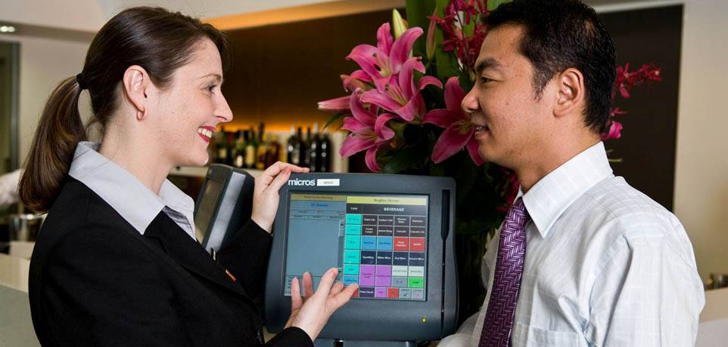
Assessment
Assessment for this unit may include:
Oral questions
Written questions
Work projects
Workplace observation of practical skills
Practical exercises
Formal report from supervisor
Notes:
Trainer advises that assessment for this Unit may take several forms all of which are aimed at verifying they have achieved competency for the Unit as required.
Trainer indicates the methods of assessment that will be applied to them for this Unit.

Slide 4
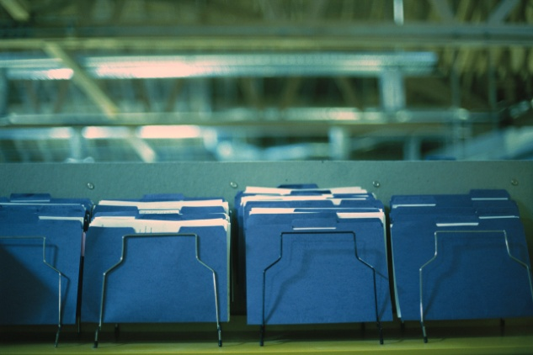
Element 1:
Maintain information systems
Notes:
Introduce topic.
Class Activity – General Discussion
Ask general questions:
What is an information system?

Slide 5
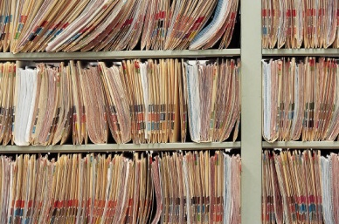
Maintain information systems
Performance Criteria for this Element are:
Information and filing systems are maintained in accordance with organisational requirements
Inactive or dead files are identified, removed and/or relocated in accordance with organisational requirements
New files are established and assembled in accordance with organisational requirements
Reference and index systems are updated in accordance with organisational requirements
Notes:
Trainer identifies the Performance Criteria for this Element, as listed on the slide.

Slide 6
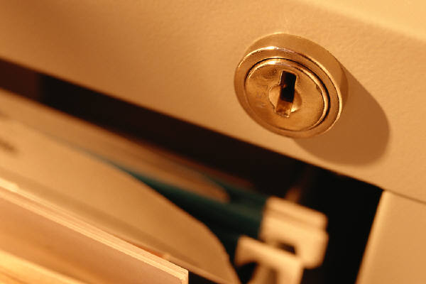
Maintain information and filing systems
Importance of hard copy information
Whilst technology is having a greater impact in the way we conduct business activities including the production, transfer and storage of information, there will always be a need to maintain hard copy information.
What is hard copy information?
What are examples of it kept in the hospitality industry?
Why is it important to store hard copy information?
Notes:
Class Activity – Questions
Discuss the questions in the slide

Slide 7
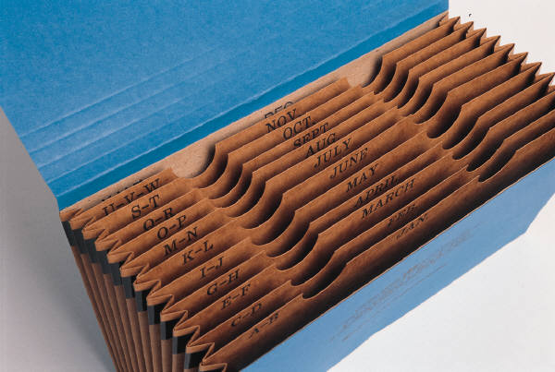
Maintain information and filing systems
Need for hard copy information
Legal reasons
Form of ‘evidence’
Back up copy
Contains original signatures
Notes:
Class Activity – Discussion
Discuss the reasons for hard copy information

Slide 8

Maintain information and filing systems
Hard copy VS Electronic information
What are the advantages of hard copy information?
What are the disadvantages of hard copy information?
What are the advantages of electronic information?
What are the disadvantages of electronic information?
Notes:
Class Activity – Questions
Discuss the questions in the slide

Slide 9
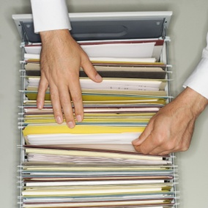
Maintain information and filing systems
Filing systems
What filing systems are used?
Why is it important to have a good filing system?
What are the characteristics of a good filing system?
Notes:
Class Activity – Questions
Discuss the questions in the slide

Slide 10
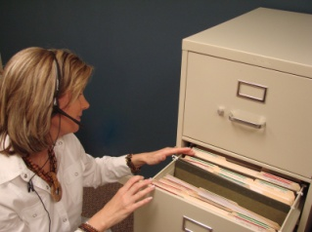
Maintain information and filing systems
Personnel handing hard copy documentation
All manner of personnel is required to handle hard copy documentation.
Who normally handles hard copy information?
What specific information do they need?
Notes:
Class Activity – Questions
Discuss the questions in the slide

Slide 11

Hard copy information
Types of generic hard copy information
Correspondence, such as faxes, memos, letters, email and other documents
Computer databases, such as library catalogue, customer records
Sales records, including monthly forecasts, targets achieved
Forms, including insurance forms, membership forms
Notes:
Class Activity – Discussion and show examples
Discuss use of each type of hard copy information
Show examples where possible

Slide 12

Hard copy information
Types of generic hard copy information
Invoices, such as from suppliers, to debtors
Personnel records, including personal details, salary rates
Information on training needs
Marketing reports, plans, budgets
Financial figures
Production targets
Notes:
Class Activity – Discussion and show examples
Discuss use of each type of hard copy information
Show examples where possible

Slide 13

Hard copy information
Financial source documents
Cheques
Deposit books
Cheque requisitions
Tax invoices
Credit notes
Expense vouchers
Petty cash vouchers
Bank statements
Notes:
Class Activity – Discussion and show examples
Discuss use of each type of hard copy information
Show examples where possible

Slide 14

Organisational requirements
Importance of having organisational requirements
Given that many of these documents are not only of a sensitive nature, but need to be stored in a logical and easy to locate manner, each organisation is likely to have a number of requirements that must be followed when handling them:
What types of requirements do organisations have?
Notes:
Class Activity – Questions
Discuss the question in the slide

Slide 15

Organisational requirements
Types of organisational requirements
Security and confidentiality requirements
Legal and organizational policy, guidelines and requirements
Management and accountability channels
Code of Conduct, Code of Ethics
Procedures for updating records
Information protocols
Notes:
Class Activity – Discussion
Discuss the requirements.
Identify what some potential policies or procedures that may be established to protect hard copy information

Slide 16

Organisational requirements
Types of organisational requirements
Who has responsibility for producing and handling documents
Who has authority for authorising documents and signing them prior to despatch
Filing and storing copies of documents
Identification of (blank and pro forma) documents that need to be prepared on a regular basis
Notes:
Class Activity – Discussion
Discuss the requirements.
Identify what some potential policies or procedures that may be established to protect hard copy information

Slide 17
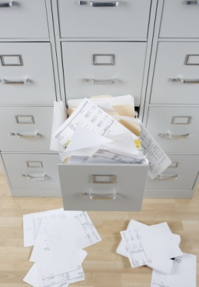
Handle inactive or dead files
Types of inactive or dead files
Inactive or dead files may include:
Completed projects or events
Old clients
Paid accounts
Ex employee information
Notes:
Class Activity – Discussion
When are they considered to be ‘inactive’ or dead’?
What is done with these files?

Slide 18
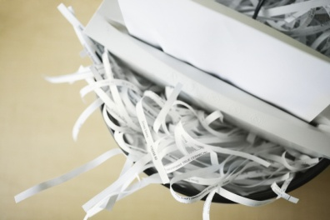
Handle inactive or dead files
Handling inactive or dead files
How should you:
Remove files
Destroy files
Notes:
Class Activity – Questions
Discuss the questions in the slide

Slide 19

Establish and assemble files
Solicit input from users
When establishing and assembling new files it is important that the end user understands:
How files will be filed
Methods of identifying files
Where they will be located
How they can be accessed
Notes:
Class Activity – Questions
Why is it important to ask others for input when setting up new files?
Who should you ask?

Slide 20
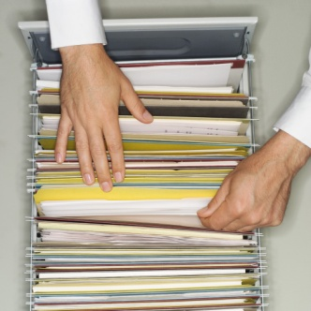
Establish and assemble files
Establishing file categories
To make a filing system more effective it is essential to group files into ‘categories’. A category is a group or a collection of files or documents that belong together.
What are examples of categories for different departments within a hotel?
What are sub-categories with these?
Notes:
Class Activity – Group activity
Get audience to list different categories and sub-categories for different positions in different hospitality departments

Slide 21
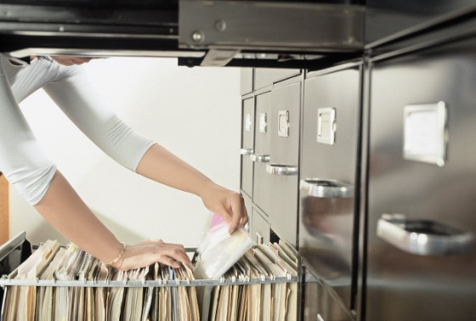
Establish and assemble files
Forming categories
Some easy to follow suggestions include:
Sort all your documents out into piles that you think belong together
Give each pile a category name
Make a list of categories
Look at your list critically
Notes:
Class Activity – Group activity
Get audience to list different categories for different positions in different hospitality departments

Slide 22
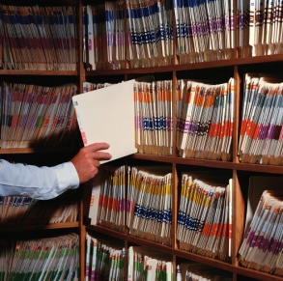
Establish and assemble files
Filing procedure
Step 1: Receiving the document
Step 2: Action
Step 3: Follow up
Step 4: Collecting Documents to be filed
Step 5: Filing
Notes:
Class Activity – Discussion
Discuss this procedure

Slide 23

Establish and assemble files
Guidelines
Have easily identifiable files and folders
File documents immediately
Have consistency amongst filing systems
Notes:
Class Activity – Discussion
What other guidelines would you have to make filing of documents easier?

Slide 24

Update reference and index systems
Role of the reference and index systems
Implementing a reference and index system enables you to file and then readily access paper-based documents:
What reference and index systems can you use?
Notes:
Class Activity – Discussion
Discuss different types of systems.

Slide 25

Update reference and index systems
Types of reference and index systems
Reference and index systems may relate to:
Alphabetic
Numeric
Alpha-numeric
Topic
Subject
Notes:
Class Activity – Discussion
Discuss different types of systems.

Slide 26
Update reference and index systems
Types of reference and index systems
Reference and index systems may relate to:
Alphabetic
Numeric
Alpha-numeric
Topic
Subject
Notes:
Class Activity – Discussion
Discuss different types of systems.

Slide 27

Element 2:
Retrieve files in response to information requests
Notes:
Introduce topic.
Class Activity – General Discussion
Ask general questions:
What actions are required when retrieving files from appropriate storage locations?

Slide 28

Retrieve files in response to information requests
Performance Criteria for this Element are:
Locate specified files or records within designated timelines
Retrieve relevant file
Record movements of documentation according to enterprise policies and procedures
Follow security and confidentiality procedures
Notes:
Trainer identifies the Performance Criteria for this Element, as listed on the slide.

Slide 29

Locate files within timelines
Locating files
One of the main priorities of using a filing system is to ensure that files and documents can be:
Located
Identified
Retrieved in a timely and efficient manner
Notes:
Class Activity – Discussion
Discuss these points

Slide 30

Types of files
Types of hospitality files and documents
Guest mail
Customer records
Incoming and outgoing correspondence
Files
Letters
Facsimiles (faxes)
Notes:
Class Activity – Discussion & Show examples
Discuss these files, their uses, who uses them
Show examples

Slide 31

Types of files
Types of hospitality files and documents
Memos
Reports
Menus
Banquet orders
Financial records
Invoices
Receipts
Notes:
Class Activity – Discussion & Show examples
Discuss these files, their uses, who uses them
Show examples

Slide 32
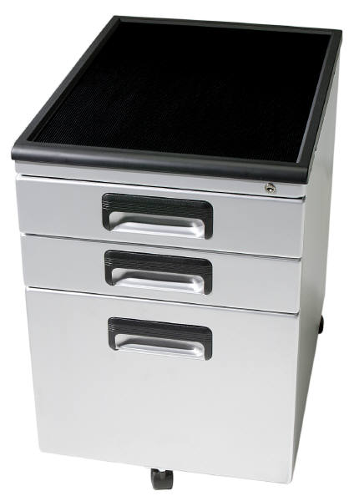
Types of systems
Types of paper based filing systems
Filing cabinets
Flat Boxes
Lever arches
Suspension folders
Shelving
Other
Notes:
Class Activity – Discussion
Provide examples of each
Filing cabinets: 3-drawer, 4-drawer, 2-drawer
Flat Boxes: Flat box file, horizontal plan file
Lever arches: Binder
Suspension folders: Hanging files
Shelving: Lateral cabinets, compactus
Other: Trolley, spike file, rotary file, concertina file

Slide 33

Retrieve relevant file
Importance of documenting file retrieval
Once the specific file has been found, it is time to retrieve it. In many cases files have been kept for a specific reason.
It is therefore important that is files are removed for whatever reason, that:
There is a written record of this removal
Files are returned
Notes:
Class Activity – Discussion
Why is this important?

Slide 34

Retrieve relevant file
Ensuring files are not lost
File Out Book:
A file-out book is simply a book in which we write
Who borrowed the file or document
Name of the file or document
When they borrowed it
When they returned it
Notes:
Class Activity – Discussion
Why is a file out book important?
What other information should be recorded in it?
Who should have control of this book?

Slide 35

Retrieve relevant file
Ensuring files are not lost
File Out Card
File-out cards are used in a filing cabinet. They are the same size as the files and are put in the place of the file, which has been borrowed:
Who borrowed the file or document
Name of the file or document
When they borrowed it
When they returned it
Notes:
Class Activity – Discussion
Why is a file out card important?
What other information should be recorded in it?
Who should have control of this book?

Slide 36
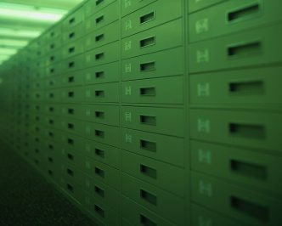
Record document movements
Benefits of recording movement of documents
This helps to identify:
Who has the physical document
Who issues or authorised the movement of the document
Where the document is currently located
Notes:
Class Activity – Discussion
Discuss these benefits

Slide 37

Record document movements
Types of document movements
There are endless types of movements involving documents including:
Recording incoming or outgoing documents
Filing including electronic filing of correspondence
Mailing
Photocopying
Faxing
Emailing
Binding
Distribution
Notes:
Class Activity – Discussion
Discuss these regular movements.
Who normally makes them?
What is involved?

Slide 38
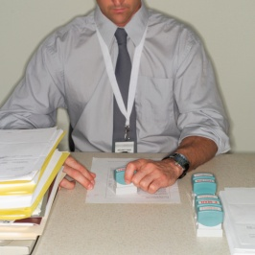
Record document movements
Ways to record movements
Ways to record movements may include:
Updating file register
Updating records management system
Temporary or permanent transfer of records
Notes:
Class Activity – Discussion
What other ways can you record movements?

Slide 39

Record document movements
Benefits of recording document movements
Establishes a transparent record of who has the document and where it has gone
Requires authorisation to receive documents
Easy to see who has received and had the opportunity to read documents
Records the time and date in which a specific person has physically received a document
Notes:
Class Activity – Discussion
What other benefits are there?

Slide 40
Follow security and confidentiality procedures
Need for security and confidentiality
Many hard copy files and documents contain information of a sensitive and confidential nature
It is essential that this information is protected in a manner that ensures that only authorised persons have access to them
Notes:
Class Activity – Discussion
What are examples of confidential files?
How can you maintain security and confidentiality?

Slide 41
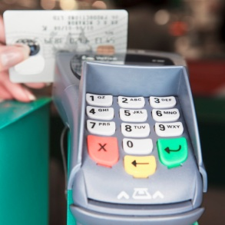
Follow security and confidentiality procedures
Types of confidential and sensitive information
Information that may be considered confidential or sensitive may include:
Personal information relating to both personnel and guests
Credit card information
Salary and benefits entitled to personnel
Personnel performance appraisal information
Notes:
Class Activity – Discussion
What do you do with this information?
How can you protect it?

Slide 42

Follow security and confidentiality procedures
Types of confidential and sensitive information
Complaints
Claims of harassment or discrimination
Financial information
Strategic information
Notes left by clients at a conference
Notes left by guests in hotel rooms
Notes:
Class Activity – Discussion
What do you do with this information?
How can you protect it?

Slide 43
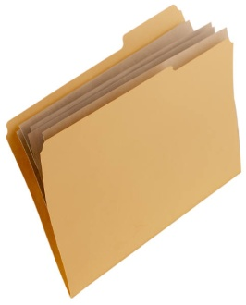
Follow security and confidentiality procedures
Importance of security
Security of documents on file is important and must be ensured to:
Protect the confidential nature of business documents
Provide back-up information in the case of computer crash
Provide hard copy evidence
Notes:
Class Activity – Discussion
Why is this important?

Slide 44
Follow security and confidentiality procedures
Types of security and confidentiality procedures
Security and confidentiality procedures may include:
Access authority
Lockable files or cabinets
Confidentiality
Notes:
Class Activity – Discussion
Discuss these measures

Slide 45

Element 3:
Maintain existing recording and filing systems
Notes:
Introduce topic.
Class Activity – General Discussion
Ask general questions:
When a business has large volumes of hard copy files, how can you maintain these systems?

Slide 46

Maintain existing recording and filing systems
Performance Criteria for this Element are:
Maintain recording and filing systems according to enterprise policies and procedures
Allocate new documents to designated category
Monitor the issue and return of documents to ensure the integrity of the system is maintained
Notes:
Trainer identifies the Performance Criteria for this Element, as listed on the slide.

Slide 47

Maintain existing recording and filing systems
Performance Criteria for this Element are:
Archive, remove and update documents to ensure appropriate space available for current records
Identify and locate required files and dispatch to nominated person or section within designated time limits
Monitor and record file and document movements
Notes:
Trainer identifies the Performance Criteria for this Element, as listed on the slide.

Slide 48
Maintain existing recording and filing systems
Performance Criteria for this Element are:
Maintain documents in good condition and in correct location
Separate confidential files from general files, with access available to nominated personnel only
Monitor security system to ensure issued files are traceable at all times
Notes:
Trainer identifies the Performance Criteria for this Element, as listed on the slide.

Slide 49

Maintain existing recording and filing systems
Maintain systems
Some documentation is kept on file because the establishment has identified a potential need for it
It is therefore important to maintain, modify and update whatever reference systems the establishment has decided to keep
This means ensuring the information contained within reports is current and accurate as much as possible
Notes:
Class Activity – Discussion
How can you maintain, modify and update information?

Slide 50

Maintain existing recording and filing systems
Legally required information
It is also a legal requirement to keep certain files in storage in case an individual needs to be located because of a criminal or civil law action, which may include:
An insurance claim being lodged
A theft from the guest’s room
A fire in the hotel
Notes:
Class Activity – Discussion
What other legal information needs to be retained and maintained?

Slide 51

Maintain existing recording and filing systems
Operational reports
Other documentation that may need to be modified and updated may include:
Arrival and departure reports
Revenue reports
In-house activity reports
Staff timesheets
Work claim forms
Accident reports
Staff rosters
Notes:
Class Activity – Discussion
What other operational reports need to be retained and maintained?

Slide 52
Allocate new documents to designated category
Techniques to organise information
Alphabetical
Numerical
Geographical
Subject
Key word
Chronological
Colour Coding
Notes:
Class Activity – Discussion
Where would these different techniques be appropriate?

Slide 53

Monitor the issue and return of documents
Files are kept in specific locations for the benefit of all staff, to help them conduct day to day activities. It is therefore important that staff has access to these files when required
If files go missing, not only does this make it inconvenient for other staff seeking information, it may also have serious confidential concerns if lost
Notes:
Class Activity – Discussion
How can you control this?

Slide 54

Monitor the issue and return of documents
Management must place a priority to monitor that any files issued have been:
Returned
In a complete format
Notes:
Class Activity – Discussion
How can you control this?

Slide 55

Monitor the issue and return of documents
Check recording systems and files
This can be achieved by ensuring the above mentioned recording systems are:
Are checked on a regular basis
Following up outstanding files with relevant persons
Conducting a ‘stock take’ of files where possible
Remind staff of the importance of returning files to original locations
Notes:
Class Activity – Discussion
Discuss the importance of these points

Slide 56

Archive, remove and update documents
Archiving
Where files or documents pass a certain time such as 12 months after their date, they may be removed and stored in a secure location for a nominated time
This time is usually 5 to 7 years
This called ‘archiving’
Notes:
Class Activity – Discussion
Where do files get archived to?

Slide 57

Archive, remove and update documents
Removing designated inactive files
Periodically, files may need to be culled or archived
These files are commonly known as ‘inactive files’
Clearing the inactive files frees up more space for current or active files
Notes:
Class Activity – Discussion
When is it time to identify and remove files?

Slide 58
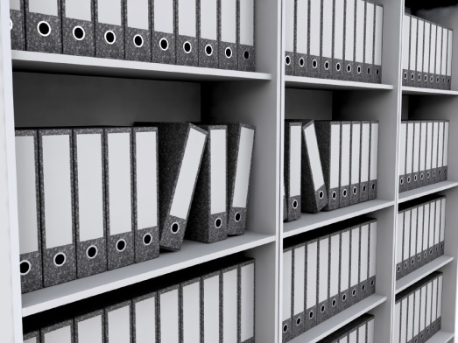
Archive, remove and update documents
Options to remove inactive files
Physically work through the files and remove anything older than a certain time
Shred anything that is remotely likely to be personal or confidential in nature
Documents may need to be archived
Notes:
Class Activity – Discussion
What other options exist?

Slide 59
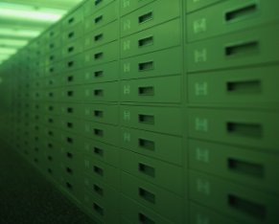
Archive, remove and update documents
Methods to archive
Archive may refer to:
Handling completed and closed files in accordance with the organization’s policy, procedure and system
Storing confidential files in an internal or external repository
Being able to retrieve archived files from storage, when required
Off-site storage
Notes:
Class Activity – Discussion
Discuss these options

Slide 60

Identify and dispatch documents
Sharing hard copy files with others
At times personnel within the hospitality organisation will seek information or access to files that may be in your possession
It is normal procedure for files to be distributed to others
Notes:
Class Activity – Discussion
Discuss these points

Slide 61
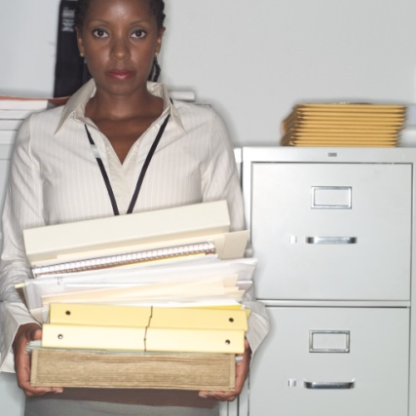
Identify and dispatch documents
Sharing hard copy files with others
Each organisation will have their own policies and procedures for transporting hard copy files to other personnel
When transporting files, the security of the files themselves and the information contained within must be maintained
Notes:
Class Activity – Discussion
Discuss these points

Slide 62

Identify and dispatch documents
Issuing files to others
When issuing files to others it is important that you ensure:
These files can easily be identified
The persons seeking the files have the authority to be given them
The files are given to them in a timely manner
They are informed that files must be recorded or signed for
Files are returned if applicable
Notes:
Class Activity – Discussion
Discuss these points

Slide 63

Identify and dispatch documents
Factors to consider when issuing files to others
Practicality of sending documents
Urgency of document to be delivered
Size of documents or files
Level of confidentiality or security required
Cost of delivery
Notes:
Class Activity – Discussion
What other factors need to be taken into account?

Slide 64

Maintain documents in good condition
Given that hard copy files are in fact physical pieces of information, it is essential that these files are looked after and kept in good working condition as much as possible.
How can you do this?
Who is responsible for it?
Notes:
Class Activity – Discussion
Discuss the questions in this slide?

Slide 65
Maintain documents in good condition
Maintaining the filing system
Keep documents that are waiting to be filed in trays, do not leave them lying about on desks or shelves.
File documents away at least once a day, or if your organisation is very small you can do it once a week
Do not put too much in files or folders
Notes:
Class Activity – Discussion
Discuss these points

Slide 66
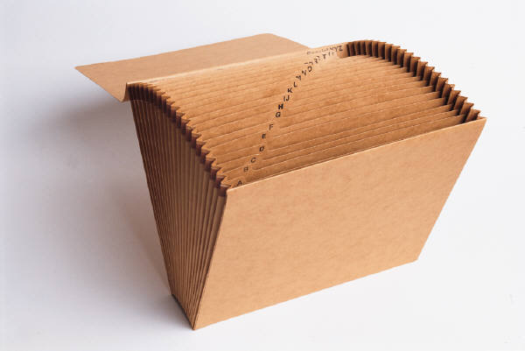
Maintain documents in good condition
Maintaining the filing system
Put new covers on old files which get a lot of use and have become worn or torn
Box files and lever arch files can hold more than simple folders
Never allow filing drawers or shelves to become too full. Acquire new filing cabinets when necessary
Notes:
Class Activity – Discussion
Discuss these points

Slide 67

Maintain documents in good condition
Good housekeeping and safety
At the end of every day you should:
File all the documents you can
Put away those you cannot file in filing trays
Lock up all confidential documents
Place all waste paper in rubbish bins
Leave desks tidy
Notes:
Class Activity – Discussion
What else can you do to maintain a clean and tidy work area?

Slide 68

Separate confidential files from general files
Confidentiality
Confidentiality is a set of rules or a promise that limits access or places restrictions on certain types of information:
What are examples of ‘general’ files?
What are examples of ‘confidential’ files?
Notes:
Class Activity – Discussion
Discuss the questions in this slide.

Slide 69

Separate confidential files from general files
Types of general files
These files are considered to be ‘general’ and contain information that helps to clarify and address operational needs including:
Expected arrivals and departures
Timing of banqueting activities
Expected VIP’s
Staff movements
Updated information or facts
Explanation of in-house promotions or menus
Notes:
Class Activity – Discussion
What are other types of general files for different departments?

Slide 70

Separate confidential files from general files
Types of confidential files
Staff personnel files
Financial information
Operational information
Commercial in confidence
Notes:
Class Activity – Discussion
What are examples of files in these categories?

Slide 71

Staff personnel files
Personnel files
Current employees in alphabetical order
Personal information
Testimonials
Job applications
Banking Details
Medical information
Notes:
Class Activity – Discussion & provide examples
Discuss confidential information contained within these files?
Who controls these files?
Who has access to these files?

Slide 72

Staff personnel files
Staff Procedures
Personnel Procedures
Conditions of Employment
Contract of Employment
Salary Information
Induction
Job descriptions
Performance Appraisals
Staff Training
Leave
Notes:
Class Activity – Discussion & provide examples
Discuss confidential information contained within these files?
Who controls these files?
Who has access to these files?

Slide 73

Financial information
Types of financial information
Budget
Salaries
Financial Statements
Petty Cash
Auditor's Statements
Tax
Strategies
Bank
Debtors
Bookkeeping
Notes:
Class Activity – Discussion & provide examples
Discuss confidential information contained within these files?
Who controls these files?
Who has access to these files?

Slide 74

Operational information
Types of operational information
Arrivals Report, Arrivals List
Departures Report, Departures List
No Show Report
Room Status Report
Special Requests Report
Occupancy Forecast Report
Average Room Rates Report
Notes:
Class Activity – Discussion & provide examples
Discuss confidential information contained within these files?
Who controls these files?
Who has access to these files?

Slide 75

Operational information
Types of operational information
Multiple or Double Room Occupancy Report
Guest List by Name Report
Guest List by Room Report
Travel Agents’ Commission Report
Special Packages Report
Market Segment Report
Rooms Out of Order Report
Notes:
Class Activity – Discussion & provide examples
Discuss confidential information contained within these files?
Who controls these files?
Who has access to these files?

Slide 76

Operational information
Types of operational information
Daily Room Revenue Summary Report
Daily Revenue Summary Report
Weekly Trading Summary Report
Monthly Trading Summary
Year-to-Date Report
In-house Activity Report
Notes:
Class Activity – Discussion & provide examples
Discuss confidential information contained within these files?
Who controls these files?
Who has access to these files?

Slide 77

Commercial in confidence
There are also other types of information that are commonly not for public viewing.
Some of these include, but certainly not limited to:
Ownership Agreements
Management Agreements
Trademark information
Strategic information
Contracts
Recipes
Business proposals
Notes:
Class Activity – Discussion & provide examples
Discuss confidential information contained within these files?
Who controls these files?
Who has access to these files?

Slide 78
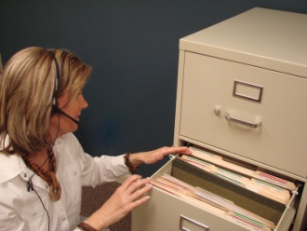
Authorised access
It is important that an authorisation system, including the physical distribution of documents and access to filing cabinets is established.
Security considerations include:
Keep office doors locked from the inside to protect against entry by unauthorised staff and members of the public
Don’t leave paperwork, documentation and records lying around where they may be visible to others
Keep ‘private’ and ‘confidential’ files locked
Notes:
Class Activity – Discussion
What else can you do to improve authorisation of information?

Slide 79

Monitor security systems
Methods to trace and secure files
Check file movement recording documentation
Follow up with staff deemed to have files at regular intervals to list on a file census form all the files held by that person
Keep a centralised record of file movements
Conduct a physical stock take of files in specific locations
Notes:
Class Activity – Discussion
What else can you do to trace and secure files?

Slide 80

Monitor security systems
Methods to trace and secure files
Issue and sign in important documents at the start and end of shift
Ask security to conduct locker or bag searches where highly sensitive information is not permitted to leave the premises
Notes:
Class Activity – Discussion
What else can you do to trace and secure files?

